Slide 1

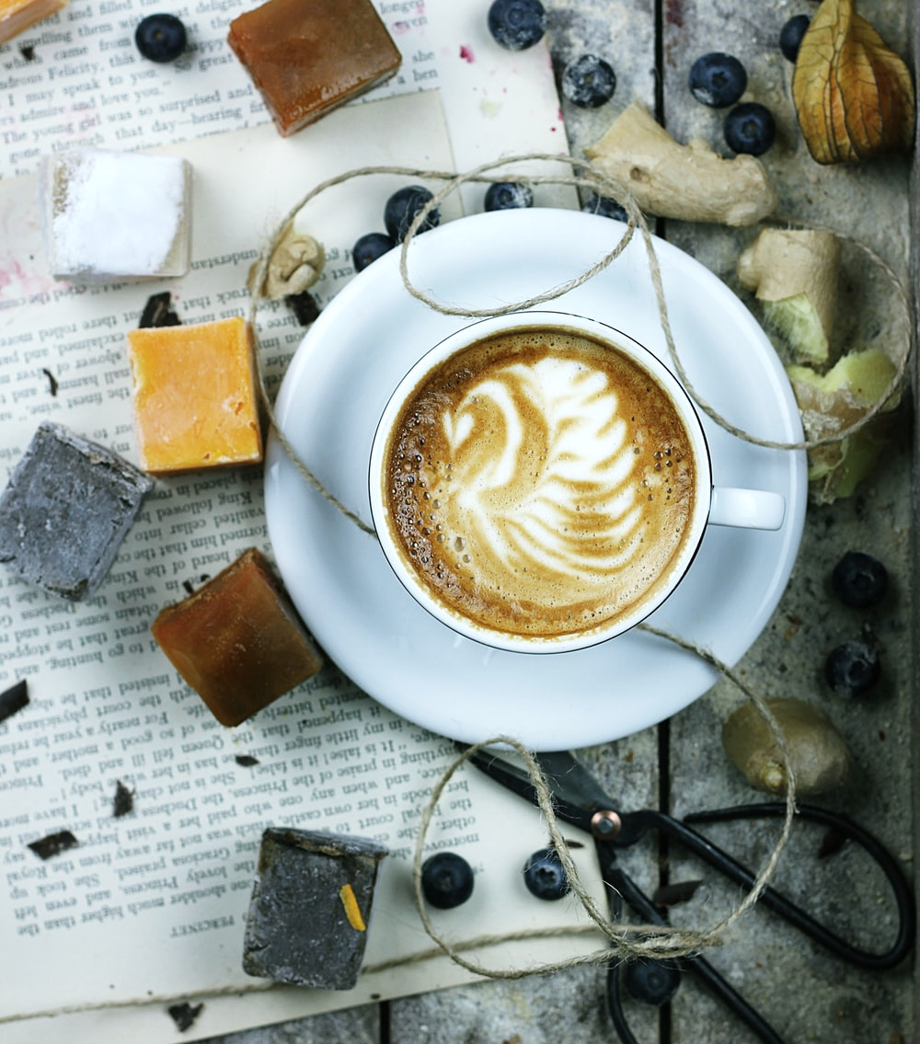

Live Class
Via Zoom
Chapter V.
Like Water for Chocolate

Slide 2



Index / Índice. “Like Water for Chocolate”
1
Introduction
6
Fill in the Blanks
2
Warm-up Speaking Practice
7
Countable or Uncountable?
3
Food Vocabulary
8
Placing an Order
4
Idioms and Figurative Meaning
9
Conversation Club
5
Food Idioms
10
What have I learnt today? …
Book II: Linda in Real Life
Centro de Idiomas 2019

Slide 3

Part I. Introduction
Welcome to this live videoconference class!
In this final part of the chapter, you’ll put into practice everything you’ve learnt in the previous steps through dialogues, monologues, group discussion, games and other fun exercises.
The class is an important moment through which you can interact with your teacher and classmates in the contextualized situations from your virtual journey to learn English aboard.
Good luck!
¡Bienvenido / Bienvenida a esta clase por videoconferencia en vivo!
En esta parte final del capítulo, pondrás en práctica todo lo que has aprendido en los pasos previos a través de diálogos, monólogos, grupos de discusión, juegos y otros ejercicios divertidos.
La clase es un momento importante a través del cual puedes interactuar con tu maestro y compañeros en las situaciones contextualizadas de tu viaje virtual para aprender inglés en el extranjero.
¡Buena suerte!
Book II: Linda in Real Life
Centro de Idiomas 2019

Slide 4
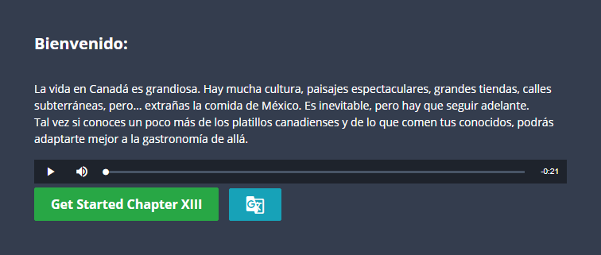
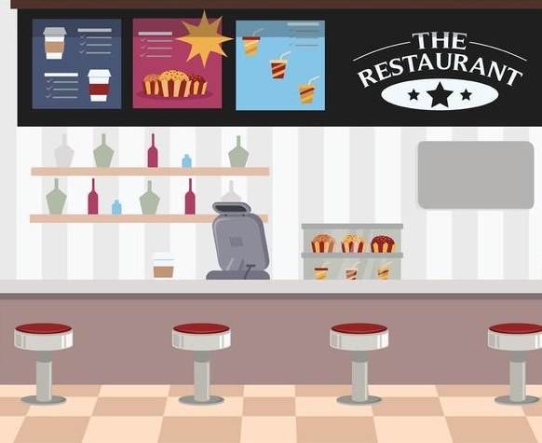
Part I. Class Objective
By the end of the class, you’ll be able to talk about food-related likes and dislikes and eating habits. You’ll practice countable and uncountable nouns, as well as use quantifiers to talk about amounts and food containers.
Al final de la clase, serás capaz de hablar de los gustos y disgustos relacionados con la comida y los hábitos alimenticios. Practicarás los sustantivos contables e incontables, así como usarás cuantificadores para hablar de cantidades y contenedores de comida.
Book II: Linda in Real Life
Centro de Idiomas 2019

Slide 5
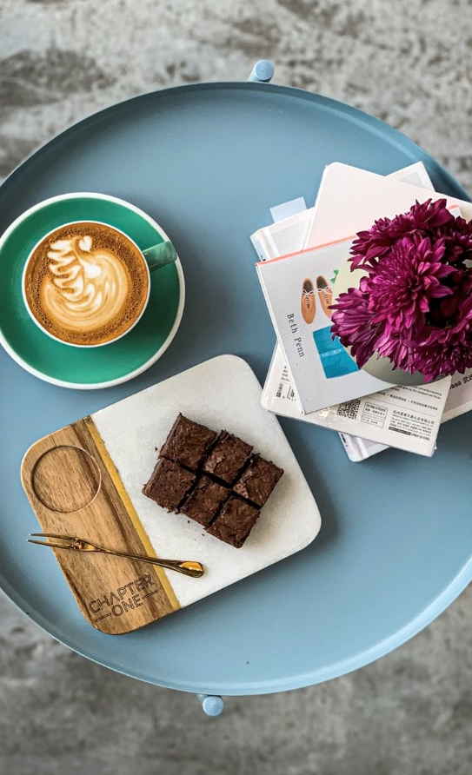
Part II. Warm-up Speaking Practice
What did you eat yesterday?
Yesterday, I ate …
What is a typical breakfast for you?
A typical breakfast for me is …..
What is your favorite recipe?
My favorite recipe is…..
What other foods do you like or dislike a lot?
I really like ……. I dislike …..
What’s the strangest food you have tried?
The strangest food I’ve tried is ……
Book II: Linda in Real Life
Centro de Idiomas 2019

Slide 6
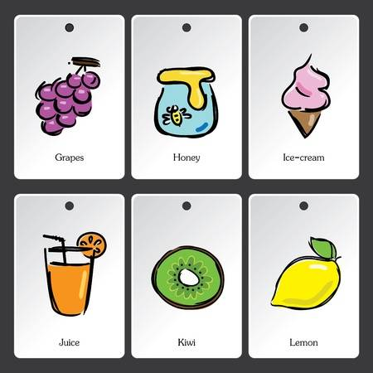
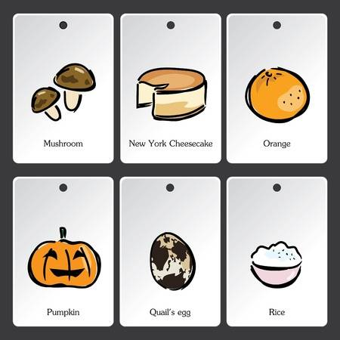
Part III. Food Vocabulary
Look at the picture and identify the foods:
You can use “there is / there are” to say complete sentences.
There is an orange .
You can also say if you like, love or dislike these foods.
I like oranges and I love orange juice .
There are purple grapes
There is honey
There is ice cream
There is orange
There is orange juice
There is kiwi
There is lemon
There us sugar
Book II: Linda in Real Life
Centro de Idiomas 2019

Slide 7
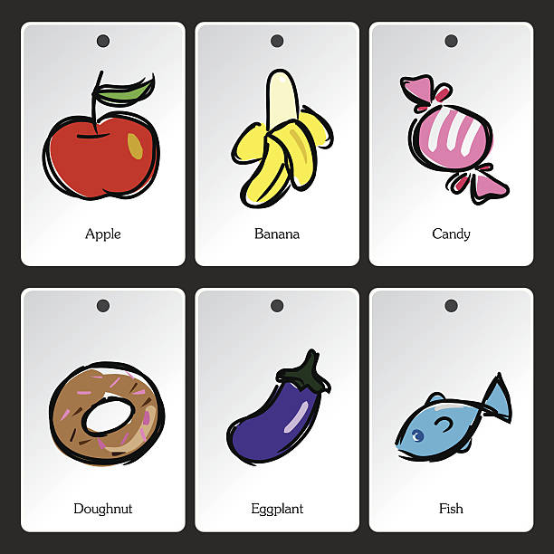
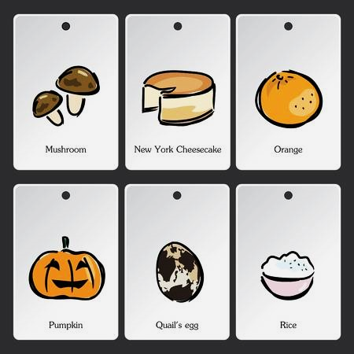
Part III. Food Vocabulary
Look at the picture and identify the foods:
You can use “there is / there are” to say complete sentences.
There is an orange .
You can also say if you like, love or dislike these foods.
I like oranges and I love orange juice .
There is apple
There is banana
There is candy
There are mushrooms
There is donut
There is eggplant
There is fish
There is pumpkin
Book II: Linda in Real Life
Centro de Idiomas 2019

Slide 8
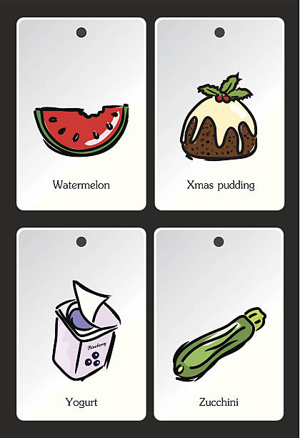
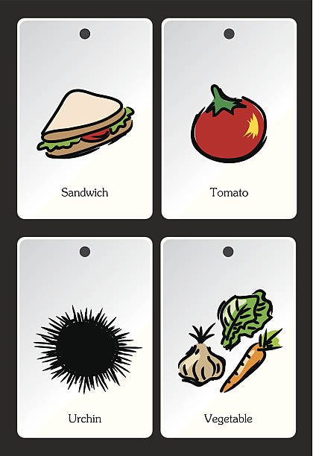
Part III. Food Vocabulary
Look at the picture and identify the foods:
You can use “there is / there are” to say complete sentences.
There is an orange .
You can also say if you like, love or dislike these foods.
I like oranges and I love orange juice .
There is watermelon
There are sandwich
There is tomatoe
There is cheese
There are garlic, lettuice and carrot
Answer
Answer
Answer
Book II: Linda in Real Life
Centro de Idiomas 2019

Slide 9

Part IV. Idioms and Figurative Meaning
Read the text and identify the food idioms:
John's dad came home one afternoon and said he could no longer bring home the bacon. His Dad said, “I lost the job that I never liked, and now I just went from the frying pan into the fire.”
John told his father he must make his bread and butter doing something he really loved to do. That way work doesn't quite feel so much like work. His dad took his advice, buttered up Steve Jobs and got a job creating iPhone apps.
His dad told John it wasn't easy working at a new job, but he had no problem remaining as cool as a cucumber under the pressure.
Book II: Linda in Real Life
Centro de Idiomas 2019

Slide 10
Part IV. Idioms and Figurative Meaning
Read the text and identify the food idioms:
John's dad came home one afternoon and said he could no longer bring home the bacon. His Dad said, “I lost the job that I never liked, and now I just went from the frying pan into the fire.”
John told his father he must make his bread and butter doing something he really loved to do. That way work doesn't quite feel so much like work. His dad took his advice, buttered up Steve Jobs and got a job creating iPhone apps.
His dad told John it wasn't easy working at a new job, but he had no problem remaining as cool as a cucumber under the pressure.
Book II: Linda in Real Life
Centro de Idiomas 2019

Slide 11
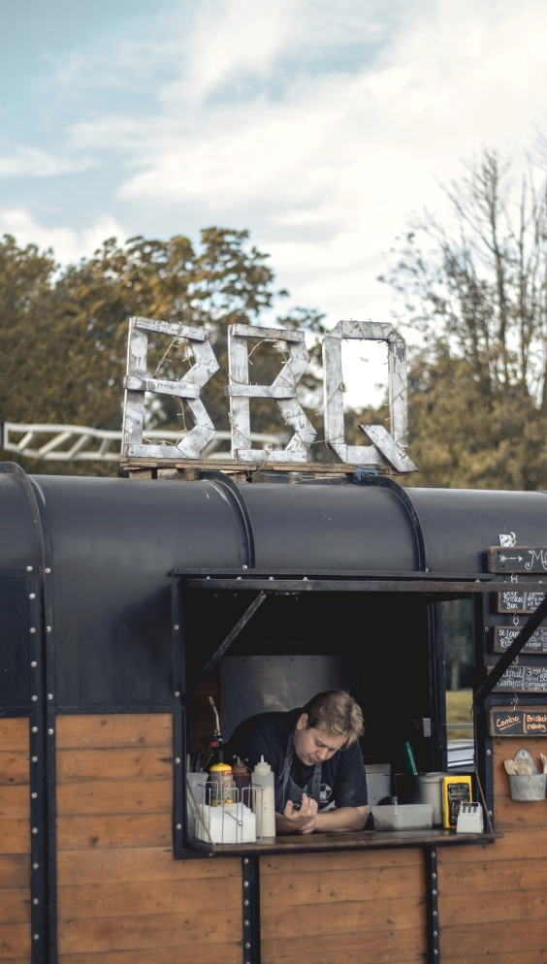
Part IV. Idioms and Figurative Meaning
What are food idioms and why do we use them?
Idioms are words or phrases that have a different meaning than the literal meaning of the word or words.
There are many examples of food idioms that are commonly used in the English language. They are not only fun to use but are sure to get your point across creatively in conversation.
Everyone loves food, and can relate to foodie phrases, but remember that food idioms do not literally mean what they say. For example, if you say someone is a "bad apple" this implies that the person is a negative influence on others or is troublesome in nature.
Book II: Linda in Real Life
Centro de Idiomas 2019

Slide 12
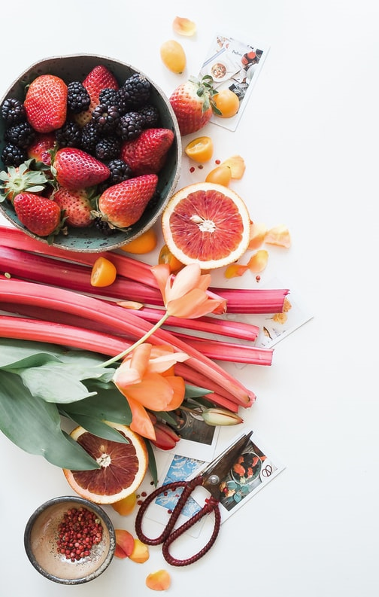
Part V. Food Idioms
Read these food idioms, their meanings and examples:
A piece of cake
When something is a piece of cake it is very easy to do.
'I was worried about taking the test, but it was a piece of cake. I got 100%.'
Bread and butter
Things which are bread and butter are the basic things you need to survive e.g. food and shelter. It is also used to describe the job or activity that provides you with the money you need to live.
'Teaching is my bread and butter.'
Bring home the bacon
Like the idiom above, this also means to earn money to live.
'I'm looking for a job. I need to do something to bring home the bacon.'
Book II: Linda in Real Life
Centro de Idiomas 2019

Slide 13
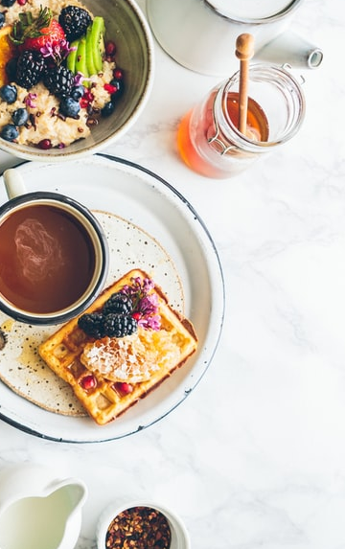
Part V. Food Idioms
Read these food idioms, their meanings and examples:
Cheap as chips
When something is as cheap as chips it is very cheap.
'I didn't pay much for these shoes. In fact, they were as cheap as chips.'
Cry over spilt milk
When we cry over spilt milk we are upset, sad or complaining over something bad that happened in the past. It is usually used in this phrase: 'There's no use crying over spilt milk.'
'Stop complaining about your lost pen - there's no use crying over spilt milk.'
Cup of tea
This expression is used in the negative. It means something is not to your interests or tastes. Basically, you don't like it.
'Rap music is not my cup of tea; I prefer rock.'
Book II: Linda in Real Life
Centro de Idiomas 2019

Slide 14
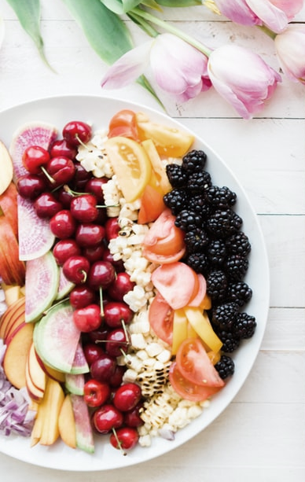
Part V. Food Idioms
Read these food idioms, their meanings and examples:
Finger in every pie
When someone has a finger in every pie they are involved in many activities and have a lot of influence, often negatively.
'He's controlling - he has a finger in every pie.'
Have one's own cake and eat it
To want more than someone can handle; to try to have two incompatible things: you can not eat the cake and still have it.
'She doesn't want to work hard, but she wants a pay rise. You can't have your cake and eat it!'
Take with a pinch of salt
To take something with a pinch of salt means that you should not completely believe what you are told.
'Take everything you read in that newspaper with a pinch of salt.'
Book II: Linda in Real Life
Centro de Idiomas 2019

Slide 15
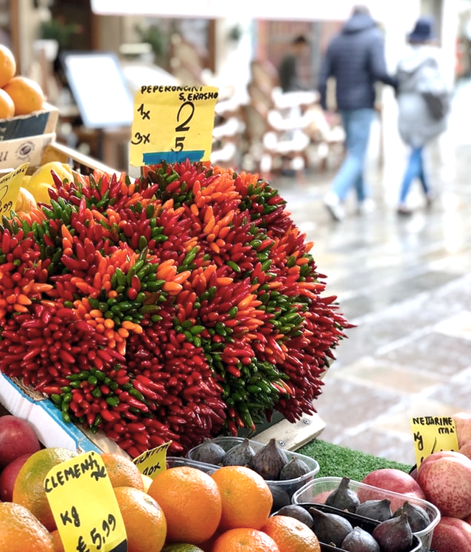
Part VI. Fill in the Blanks
Complete the idioms with the correct food:
That guy has a finger in every pie.
lemon
pie
milk
cake
They talked about the bread and butter issues.
chips
bacon
milk
butter
It's no use crying over spilt milk.
milk
salt
tea
cake
Book II: Linda in Real Life
Centro de Idiomas 2019

Slide 16
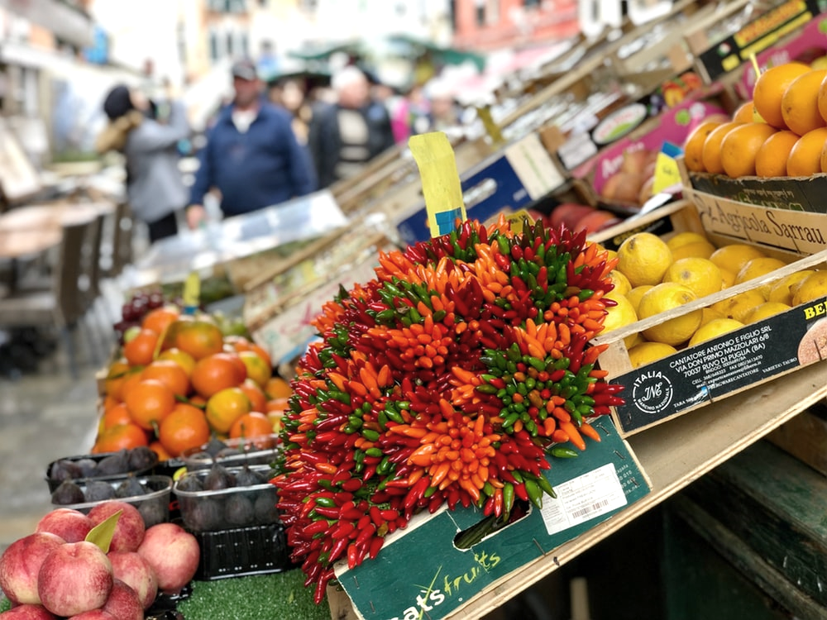
Part VI. Fill in the Blanks
Complete the idioms with the correct food:
It wasn't difficult. It was a piece of cake.
tea
cake
salt
bread
Hiking is not my cup of tea.
tea
lemon
salt
milk
Take what he said with a pinch of salt.
bacon
salt
bread
pie
Book II: Linda in Real Life
Centro de Idiomas 2019

Slide 17
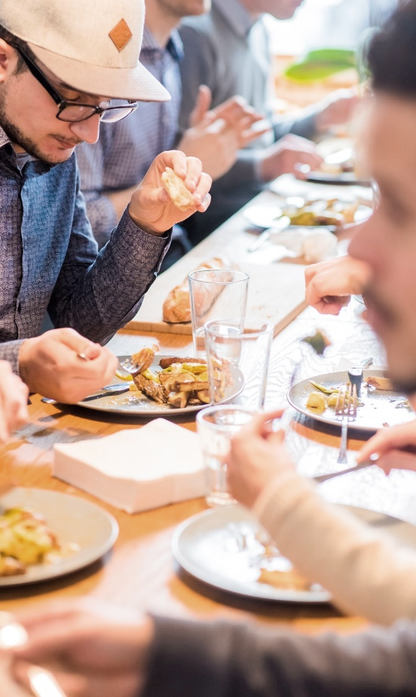
Part VI. Fill in the Blanks
Select 3 idioms and write sentences that apply to your life.
1. A piece of cake
2. Bread and butter
3. Bring home the bacon
4. Cheap as chips
5. Cry over spilt milk
6. Cup of tea
7. Finger in every pie
8. Have one's own cake and eat it
9. Take with a pinch of salt
10. Cool as a cucumber
Example:
I’m studying Information Technology and working in a computer store. That’s my bread and butter.
Book II: Linda in Real Life
Centro de Idiomas 2019

Slide 18
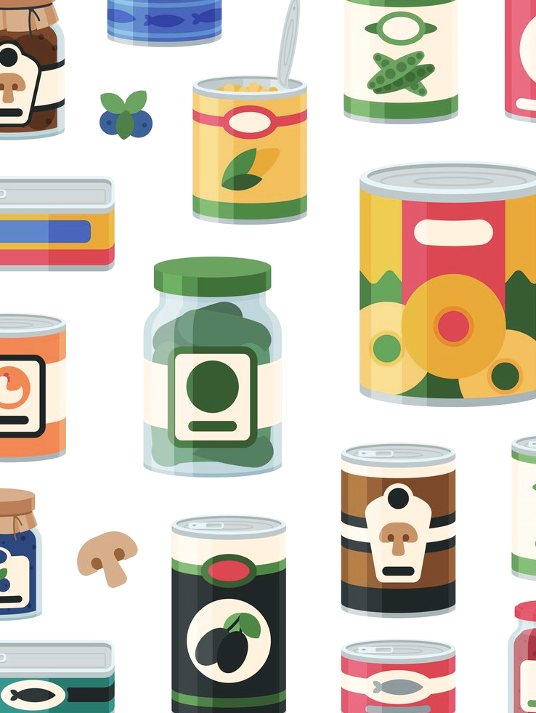
Part VII. Countable or Uncountable?
Countable nouns are individual objects, people, places, etc. which can be counted. books, Italians, pictures, stations, men, etc.
Examples:
There is a book on the table.
That student is excellent! There are some students in the classroom.
Those houses are very big, aren't they?
A countable noun can be both singular - a friend, a house, etc. - or plural - a few apples, lots of trees, etc.
Book II: Linda in Real Life
Centro de Idiomas 2019

Slide 19
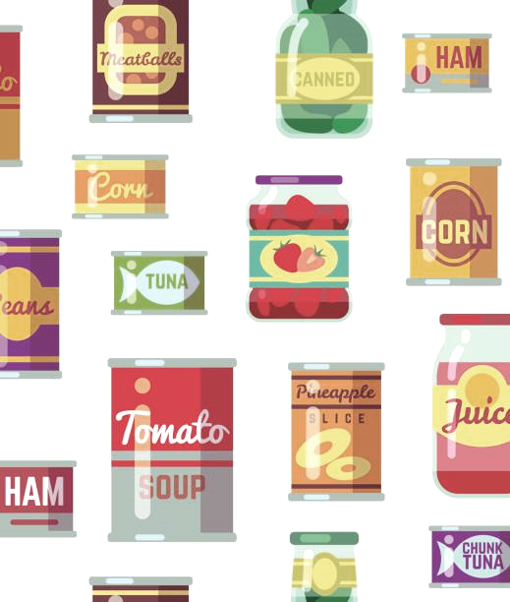
Part VII. Countable or Uncountable?
Uncountable nouns are always singular.
Use the singular form of the verb with uncountable nouns:
Example:
1. There is some water in that pitcher.
2. That is the equipment we use for the project.
3. I've got a little money.
Uncountable nouns are materials, concepts, information, etc. which are not individual objects and can not be counted.
Book II: Linda in Real Life
Centro de Idiomas 2019

Slide 20
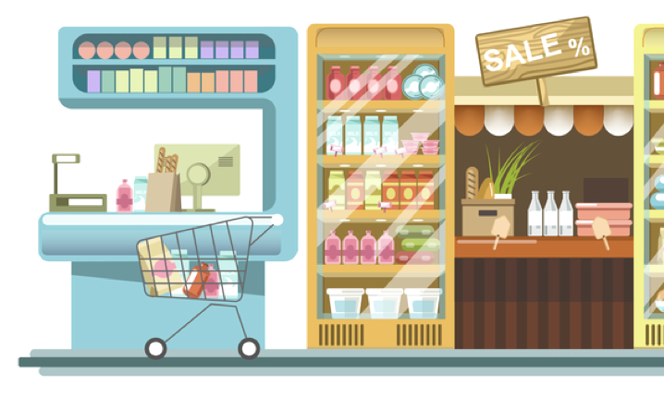
Part VII. Countable or Uncountable?
furniture
garbage
information
knowledge
money
news
progress
research
travel
work
accommodation
advice
equipment
Here is a list of some of the most common, easy to confuse uncountable nouns:
Book II: Linda in Real Life
Centro de Idiomas 2019

Slide 21
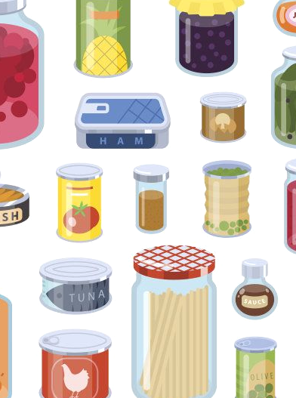
Part VII. Countable or Uncountable?
Obviously, uncountable nouns (especially different types of food) have forms that express plural concepts. These measurements or containers are countable:
water - a glass of water
bread- a piece of bread
cheese - a slice of cheese
Question Form
For uncountable nouns, we use ‘how much’:
How much water is left in the bottle?
For countable nouns, we use ‘how many’:
How many apples are on the table?
Book II: Linda in Real Life
Centro de Idiomas 2019

Slide 22
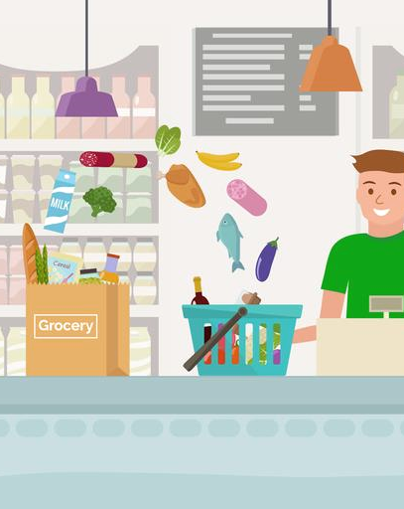
Part VII. Countable or Uncountable?
Can you remember the uncountable food nouns and their containers?
Complete the phrases below with their nouns:
A glass of …
A bottle of …
A bag of …
A cup of…
A can of…
A slice of…
A stick of…
A kilo of…
A carton of…
A plate of…
Book II: Linda in Real Life
Centro de Idiomas 2019

Slide 23
Part VII. Countable or Uncountable?
Can you remember the uncountable food nouns and their containers?
Complete the phrases below with their foods:
A glass of wine
A bottle of water
A bag of sugar
A cup of coffee
A can of soda
A slice of cheese
A stick of butter
A kilo of rice
A carton of milk
A plate of food
Book II: Linda in Real Life
Centro de Idiomas 2019

Slide 24
Part VII. Countable or Uncountable?
We use the following quantifiers with countable nouns:
There are too many bananas.
a few apples.
(very) few donuts.
not many biscuits.
plenty of peas.
a lot of / lots of nuts.
(not) enough tomatoes.
hardly any eggs.
no pineapples.
We use the following quantifiers with uncountable nouns:
There is too much fruit.
a little milk.
(very) little cheese.
not much orange juice.
plenty of salt.
a lot of / lots of sugar.
(not) enough water.
hardly any rice.
no butter.
Book II: Linda in Real Life
Centro de Idiomas 2019

Slide 25
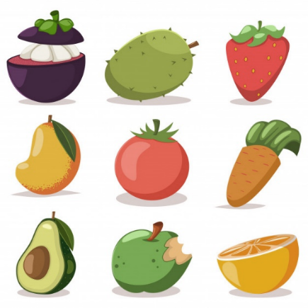
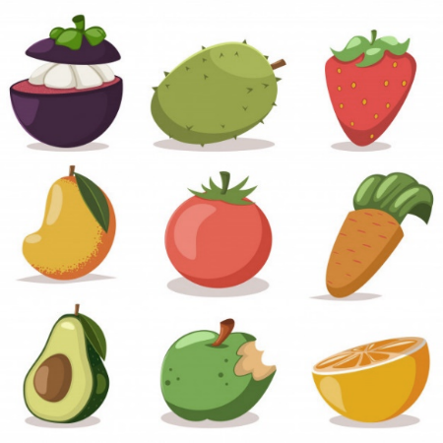

Part VII. Countable or Uncountable?
Fill in the blanks below using “little” or “few”:
1. There is few money in the wallet.
2. I’ve got a few books.
3. My mum has got a few cigarettes in the packet.
4. I can’t wait for you. I’ve got little time.
5. Fred has got a few English books.
6. Brenda has got a few friends.
7. There is little butter left. We need to buy some.
8. There are a few people at the cinema.
9. I have got few magazines. I prefer books.
10. There is a few pizza in the fridge if you are hungry.
Book II: Linda in Real Life
Centro de Idiomas 2019

Slide 26
Part VII. Countable or Uncountable?
Fill in the blanks using “much” or “many”.
1. How much books did you buy?
2. How much money do you have
3. How much did the car cost?
4. How much apples are there in the basket?
5. How many times have you been to the dentist?
6. How many butter do you need?
7. How many oranges do you want?
8. How many wine does he drink?
9. How many girls are there in your class?
10. How much stamps have you got in your collection?
Book II: Linda in Real Life
Centro de Idiomas 2019

Slide 27
Part VII. Countable or Uncountable?
Fill in the blanks using “a/an”, “ some”, “any” , “much” or “many”.
1. I ate some sandwich for lunch.
2. We had many cake with the tea.
3. I often have an fried egg for dinner.
4. There aren’t many pears left. Only two.
5. Would you like a tea?
6. Don’t eat so much chocolate or you’ll get fat.
7. I don’t drink any beer. I don’t like it.
8. There is a tub of margarine in the fridge.
9. The child put some sand into the bucket.
10. I can lend you some money if you need it.
Book II: Linda in Real Life
Centro de Idiomas 2019

Slide 28
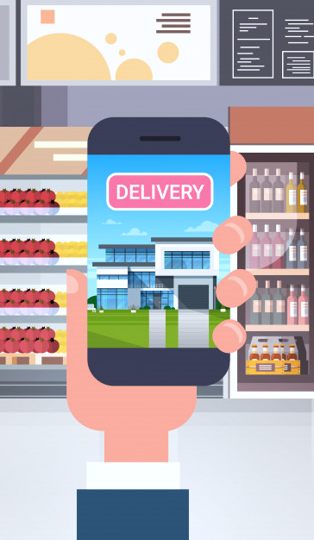
Part VIII. Placing an Order
You are going to place an order to have the food delivered for your favorite recipe.
First, you want to know what the store has and how much is in stock.
One student will ask the questions; the other will answer with quantifiers.
Example:
Customer: How many apples do you have?
Staff: We have a lot of apples.
Customer: How much milk do you have?
Staff: We have a little milk.
Customer: How much bread do you have?
Book II: Linda in Real Life
Centro de Idiomas 2019

Slide 29
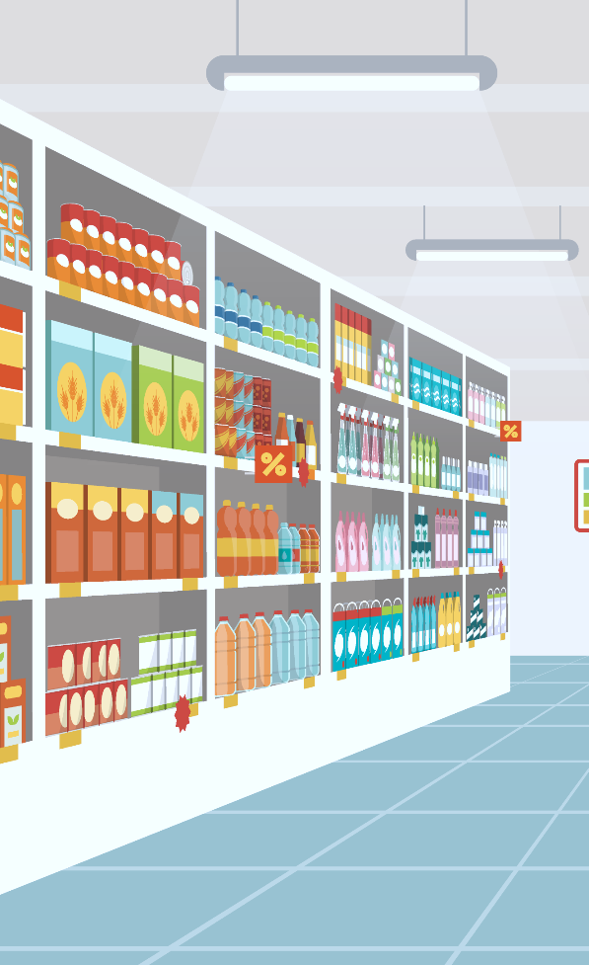
Part IX. Conversation Club
To finish the class, let’s talk about different topics on food and your personal preferences.
Example:
Do you like fast food?
Do you prefer fast food or home-cooked food?
What Mexican food do you like?
What international food do you eat?
Are you a healthy eater?
What do you eat in a typical week.
What is good and bad about fast food?
What’s your favorite restaurant? Why?
What’s your favorite food? Why?
Are you good at cooking?
Book II: Linda in Real Life
Centro de Idiomas 2019

Slide 30
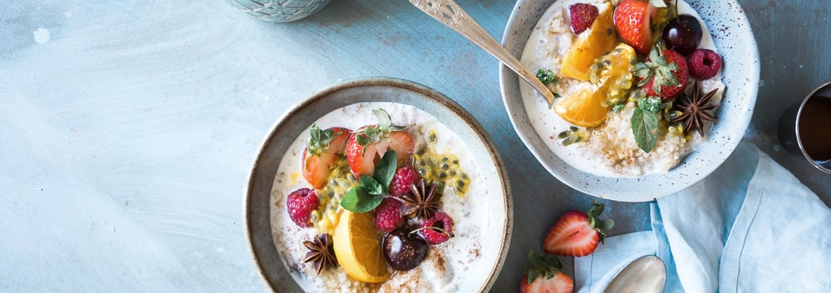
Part X. What have I learnt today?
What have I learnt today?
You can now talk about food-related likes and dislikes and eating habits, practice countable and uncountable nouns, as well as use quantifiers to talk about amounts and food containers.
Book II: Linda in Real Life
Centro de Idiomas 2019

